Slide 1
A theory of anomia
Martin Neumann
JGU Mainz

Slide 2
Introduction
Presentation of conceptual model
Target of the model: social norms that regulate social relations in criminal groups & organizations
Challenge for criminal organizations: outside state monopoly of violence
Norm enforcement cannot be delegated to the state
Norms and SIA: Sociological theory of groups relations
Theory of anomia: On the edge of SIA
Other contributions – more in the core of SIA – would have been possible but perhaps a possibility to span (together with other contributions from other group members) the whole reach of SIA and related fields

Slide 3
Background
Conceptual model based on qualitative data analysis of police interrogations (Thick description)
Case: violent collapse of criminal group
Puzzle:
Some were extremely rich
own private jets
Group extremely successful
Why murder?
in vivo code: ‘Hen with golden eggs’ (victim of assassination)

Slide 4
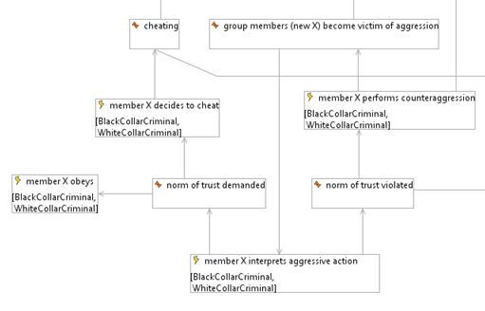
Conceptual model of norm enforcement
Reasoning about aggression
Norm enforcement (Sanction)
Norm deviation (Self interest)
Interpretation as norm deviation
Positive feedback: unstable behaviour
Feedback loop

Slide 5
A theory of anomia
How to avoid positive feedback loop?
Theory of the third party (Simmel 1908, Lindemann 2014)
Validity of normative claims decided by third party
Conflicting parties agree on a common third party (Hobbes’ “Leviathan”)
E.g. resolving disputes in court
Criminal network
Flat network structure: No commonly agreed third party between Ego and Alter
E.g. Secretly contacting police, outlaw gang (ego)
Interpretation of aggression as norm deviation by Alter

Slide 6
Conclusion: anomia and SIA
Common puzzle of social norms and social identity
Possibility of social order
Divergence
Theory of anomia based on theory of the third party
Focus on network structure
Social identity Approach
Focus on individual cognition (SCT)

